Slide 1

Introduction to devOps

Slide 2









Agenda
WHAT IS SOFTWARE DEVELOPMENT?
WATERFALL MODEL
AGILE MODEL,
LEAN MODEL
WATERFALL VS AGILE VS LEAN
WHY DEVOPS?
DEVOPS LIFECYCLE
WHAT IS DEVOPS?
DEVOPS TOOLS

Slide 3
What is Software Development?

Slide 4
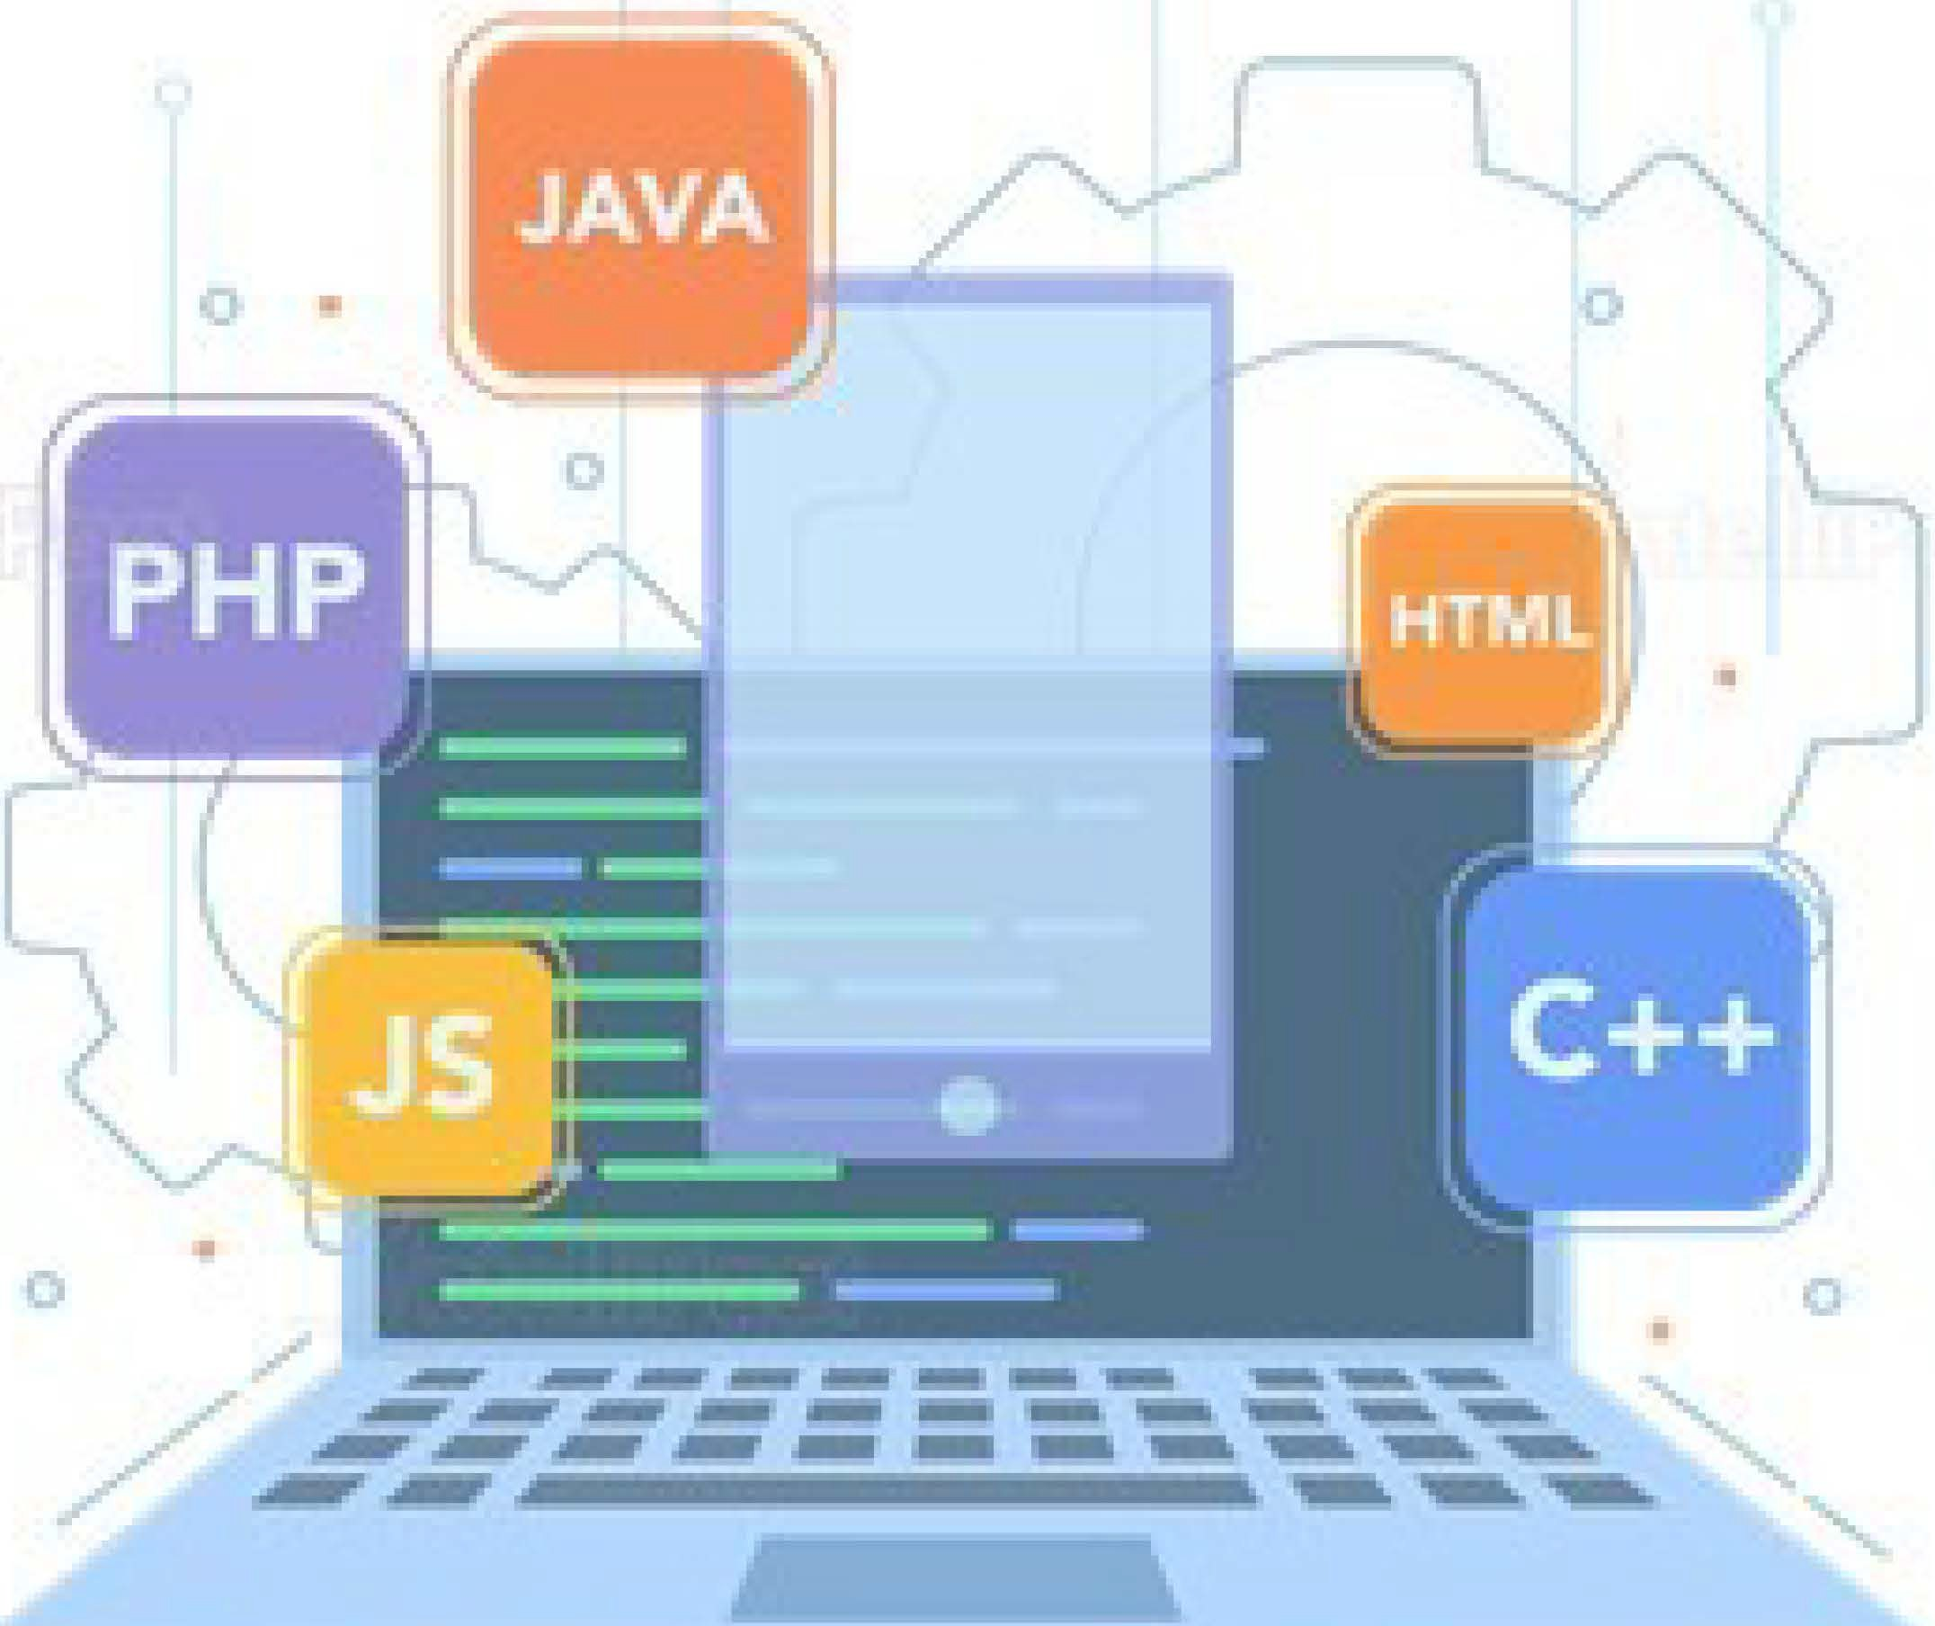
What is Software Development?
Soltware DeveIopment is the process of transforming customer requirements into a complete soltware product.

Slide 5


Software Development Life Cycle
ln broader terms , software development involves the following stages:
Requirements
Design
Implementation Verification Maintenance

Slide 6

Software Development Life Cycle
Requirements
This is the most important phase in the software deveIopment Iifecycle. In this stage, the requirements. are gathered from the customers and the requirements are then analysed to ensure their feasibility.
Design
Implementation
Verification
Maintenance

Slide 7



Software Development Life Cycle
Requirements
Once the requirements are received, the architect transforms these requirements into technical specifications and plan the software components which have to be designed
Design
Implementation
Verification
Maintenance

Slide 8

Software Development Life Cycle
Requirements
The specifications are then passed on to the developers which create the application based on these specifications
Design
Implementation
Verification
Maintenance

Slide 9

Software Development Life Cycle
Requirements
Once the development work is done on the application. It is verified by a group of testers to map the application's functionalities with the specification given by customers
Design
Implementation
Verification
Maintenance

Slide 10

Software Development Life Cycle
Requirements
Once the code is verified, it is pushed to production. Post this, the application is updated with any future enhancements or optimizations, if and when required.
Design
Implementation
Verification
Maintenance
I

Slide 11
SDLC Models
Since the time soltware development started, various software deveIopment modeIs have been curated which implement SDLC. Each of these models solve problems that existed before these models were invented.
Traditionally, there have been 3 major software development models that most companies follow·:
Waterfall Model
Agile Model Lean Model

Slide 12
Waterfall Model

Slide 13
Waterfall Model
Feasibility Check
Analysis
waterfall Model was among the first development models which followed SDLC
Design
The Waterfall model follow a Iinear sequential model of development i.e until the first stage is not finished, the next stage will not start
Coding & unit testing
•
Integration & system testing
Maintenance of Software

Slide 14


Advantages of Waterfall Model
-•-
Clear Objectives
Specific Deadlines
No ambiguous requirements
Well understood milestones
--·
Process and results are well documented

Slide 15


Disadvantages of Waterfall Model
Working Product is not available until the later stage in lifecycle
Poor model for large and complex projects
Cannot accommodate changing requirements
High risk and uncertainty

Slide 16
Agile Model

Slide 17

Agile Model
Priority
request
Design
Coding
Test& Debugging
Release &
Deployment
To overcome the challenges faced in the Waterfall Model, we came up with the Agile Methodology
Agile Method believes in creating shorter development lifecycles
Shorter Development Lifecycles are achieved by not releasing all the features at once by following an incremental model of development

Slide 18

Advantages of Agile Model
Customer Satisfaction is hig
Less Planning Required
Requirements can be, dynamic in nature,
functionality can be created and tested ,quicky

Slide 19

Disadvantages of Agile Model
Not suitable for hairndling oomplex dependencies in projects
Knowledge transfer to colleagues can be difficult since there is Iittle documerritation
Success of the project depends eavily o customer interaction

Slide 20
Lean Model

Slide 21

7 Principll es of Lean Methodology
Lean Model
Eliminate Waste
Amplify learning
Decide as late as possible DeIiver as fast as possible Empower the team
BuiId Integrity
See the whole
Lean development is a philosophy of
increasing quality in software delivery by
making use of agile methods
Ignore the clutter for later and focus on
what is required now
Lean Methodology has it's primary focus
on two things — Respect for frontline
workers and Continuous Improvement

Slide 22
Advantages of earn Model
Canies the same advantages as Agile Methodology
Creates a positive working environment
Customer Feedback is given the utmost importance
Limiting Wastes saves time and money

Slide 23
Disadvantages of Lean Model
Largely dependent on the skill set of the
team, therefore requires a strong team
No room for error, a missed delivery can
be bad for business
Success of the project depends heavily on customer interaction

Slide 24
Waterfall vs Agile vs Lean

Slide 25
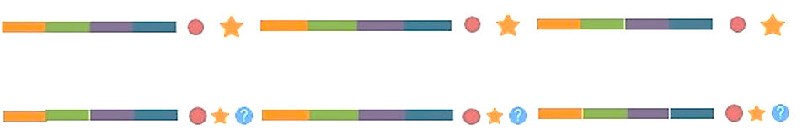

Waterfall vs Agie vs Lean
Waterfall Model
Agile Model
Lean Model
Requirements
Design Implementation
Verification Release
Customer Feedback Eliminate waste

Slide 26

Summarizing
Problem with Waterfall Model was, the development lifecycle took a lot of time to complete. Therefore, by the time
finished product was delivered, the customer requirements were no longer the same.
Customers.
Software Company

Slide 27

Summarizing
This problem was fixed by Lean and Agile methodologies. These methodologies strictly focussed on customer
feedback and improving the software quality that too in a shorter development lifecycle
Customers
Software Company

Slide 28
Summarizing
This problem was fixed by Lean and Agile methodologies. These methodologies strictly focussed on customer
feedback and improving the software quality that too in a shorter development lifecycle
Customers.
Software Company
Why do we need DevOps!?

Slide 29
Why DevOps?

Slide 30
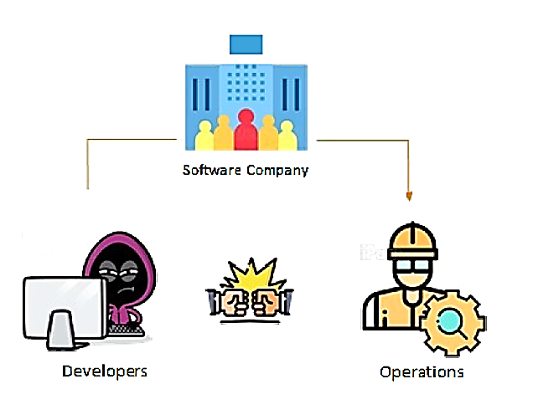
Why DevOps?
Although, the software quality was improved.
We still had a lack of efficiency among the
development team. A typical software
development team consists of Developers and
Operations employees. Let us understand their
job roles

Slide 31


Why DevOps?
A developer's job is to develop
applications and pass his code to the
operations team
The operations team job is to test the
code, and provide feedback to
developers in case of bugs. If all goes
well, the operations team uploads the
code to the build servers
Developer
Operations

Slide 32



Why DevOps?
Developer
Operations
The developer used to run the
code on his system, and then
forward it to operations team.
The operations when tried to
run the code on their system,
it did not run!

Slide 33

Why DevOps?
Developer
Operations
But, the code runs fine on the
developer's system and hence
he says "It is not my fault!"
The operations then marked
this code as faulty, and used
to forward this feedback to
the developer

Slide 34



Why DevOps?
Developer
Operations
This led to a lot of back and forth between the developer and the operations team,
hence impacted efficiency.

Slide 35
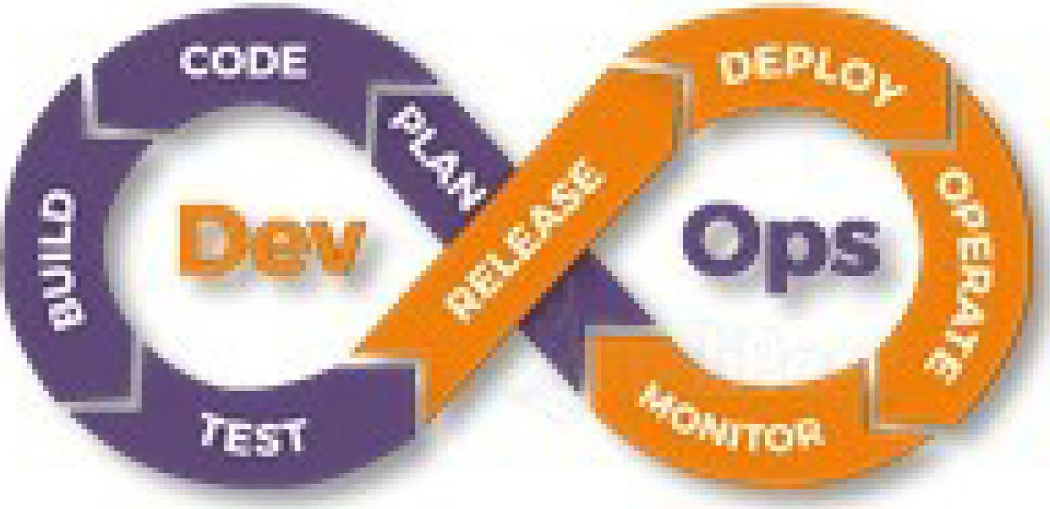
Why DevOps?
Developer
Operations
This problem was soIved using Devops !

Slide 36
Traditional IT vs DevOps
Traditional IT | Devops
Less productive | More Productive
Skill centric team | Team is divided into specialized silos
More time invested planning | Smaller and frequent releases lead to easy scheduling and less time in planning
Difficult to achieve target or goal | Frequent releases, with continuous feedback makes achieving targets easy

Slide 37
What is Devops?

Slide 38
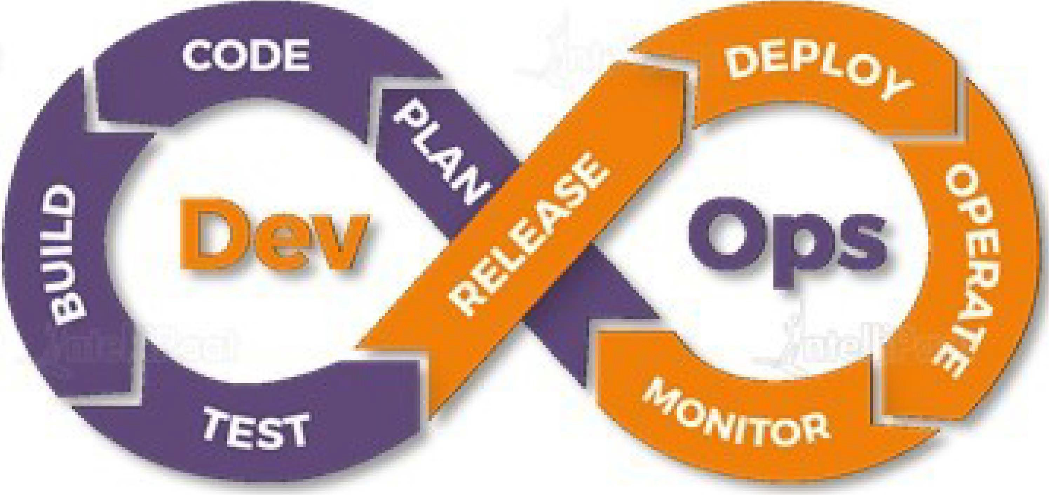
What is DevOps?
Devops is a software development methodology which improves the collaboration
between developers and operations team using various automation tools. These
automation tools are implemented using various stages which are a part of the Devops
Lifecycle

Slide 39
DevOps Lifecycle

Slide 40
How DevOps Works?
The Devops Lifecyde divides the SDLC lifecyde into the following stages:
Plan
Release
Continuous Development
Continuous Deployment
Code
Continuous
Integration
Deploy
Build
Operate
Continuous Testing
Continuous
Monitoring
Test
Monitor

Slide 41
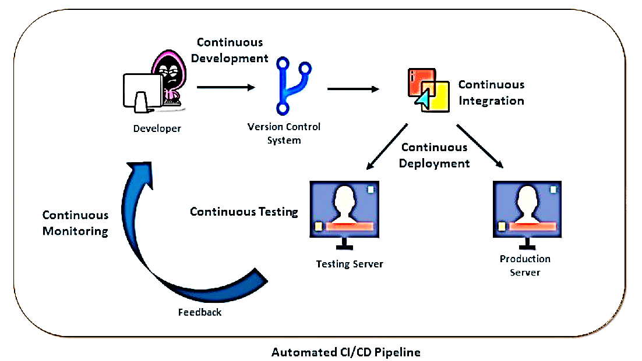
How DevOps Works?

Slide 42

How DevOps Works?
Continuous Development
This stage involves committing code to version control tools such as Git or SVN for maintaining the different versions of
the code, and tools like Ant, Maven, Gradle for building/ packaging the code into an executable file that can be forwarded to the QAs for testing.
Continuous Integration
Continuous Deployment
Continuous Testing
Continuous Monitoring

Slide 43

How DevOps Works?
Continuous Development
The stage is a critical point in the whole Devops Lifecycle. It deals with integrating the different stages of the devops lifecycle, and is therefore the key in automating the whole Devops Process
Continuous Integration
Continuous Deployment
Continuous Testing
Continuous Monitoring

Slide 44
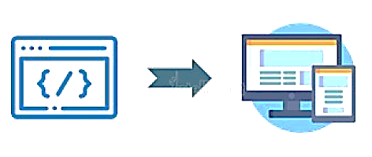
How DevOps Works?
Continuous Development
In this stage the code is built, the environment or the application is containerized and is pushed on to the desired server. The key processes in this stage are Configuration Management, Virtualization and Containerization
Continuous Integration
Continuous Deployment
Continuous Testing
Continuous Monitoring

Slide 45


How DevOps Works?
Continuous Development
The stage deals with automated testing of the application pushed by the developer. If there is an error, the message is
sent back to the integration tool, this tool in turn notifies the developer of the error. If the test was a success, the message is sent to Integration tool which pushes the build on the production server
Continuous Integration
Continuous Deployment
Continuous Testing
Continuous Monitoring

Slide 46


How DevOps Works?
Continuous Development
The stage continuously monitors the deployed application for bugs or crashes. It can also be setup to collect user feedback. The collected data is then sent to the developers to improve the application
Continuous Integration
Continuous Deployment
Continuous Testing
Continuous Monitoring

Slide 47
Devops Tools

Slide 48
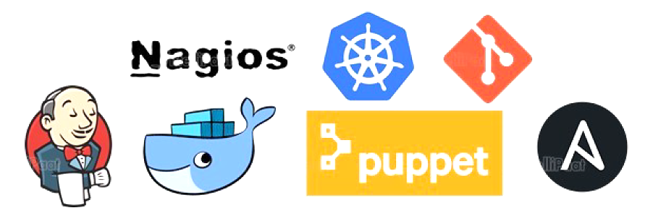
DevOps Tools
We have discussed the Devops Methodology, but this methodology cannot be put into action without it's corresponding tools. Letus discuss the devops tools with their
respective lifecycle stages

Slide 49

DevOps Tools
Continuous Development
Git is a distributed version-control system for tracking changes in computer files and coordinating work on those files among multiple people. It is primarily used for source-code management in software development, but it can be used to keep track of changes in any set of files
Continuous Integration
Continuous Deployment
Continuous Testing
Continuous Monitoring

Slide 50

DevOps Tools
Continuous Development
Jenkins is an open source automation server written in Java.
Jenkins helps to automate the non-human part of the
software development process, with continuous integration and facilitating technical aspects of continuous delivery
Continuous Integration
Continuous Deployment
Continuous Testing
Continuous Monitoring

Slide 51

DevOps Tools
Continuous Deployment
Continuous Development
Continuous Integration
Virtualization &
Containerization
Configuration Management
Continuous Deployment
>puppet
Continuous Testing
A
Continuous Monitoring

Slide 52
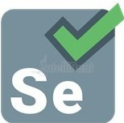
DevOps Tools
Continuous Development
Selenium is a portable sohware-testing framework used for web applications. It is an open source tool which is used for automating the tests carried out on web browsers (Web
applications are tested using any web browser).
Continuous Integration
Continuous Deployment
Continuous Testing
Continuous Monitoring

Slide 53



DevOps Tools
Continuous Development
Nagios is an open-source devops tool which is used for monitoring systems, networks and infrastructure. It also offers monitoring and alerting services for any configurable event.
Continuous Integration
Continuous Deployment
Continuous Testing
ios®
Continuous Monitoring

Slide 54
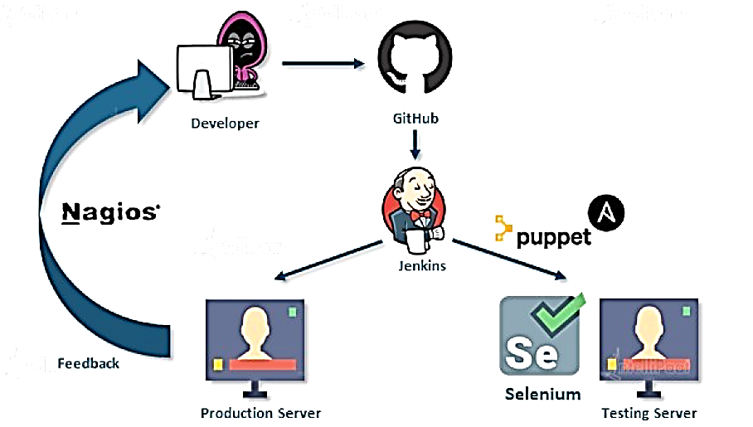
DevOps Tools

Slide 55
Quiz

Slide 56
Quiz
1. Which of these Software Development Methodologies are not suitable for large and complex projects?
A. Waterfall Model
B. Devops
C. Agile Methodology
D. None of these

Slide 57
Quiz
1. Which of these Software Development Methodologies are not suitable for large and complex projects?
A. Waterfall Model
B. Devops
C. Agile Methodology
D. None of these

Slide 58
Quiz
2. Devops Methodology was focused on solving the problems between the customers and the software company.
A. True
B. Flase

Slide 59
Quiz
2. Devops Methodology was focused on solving the problems between the customers and the software company.
A. True
B. Flase

Slide 60
Quiz
3. Which of these principles are NOT included in Agile Methodologies?
A. Frequent Release Cycles
B. Focus on Customer Feedback
C. Eliminating Waste
D. None of these

Slide 61
Quiz
3. Which of these principles are NOT included in Agile Methodologies?
A. Frequent Release Cycles
B. Focus on Customer Feedback
C. Eliminating Waste
D. None of these

Slide 62
Quiz
4. which lifecycle stage in Devops helps in Transition from one stage to another?
A. Continuous Development
B. Continuous testing
C. Continous monitoring
D. Continous integration
'�====�=========_{-;;;;;;;#"}

Slide 63
Quiz
4. which lifecycle stage in Devops helps in Transition from one stage to another?
A. Continuous Development
B. Continuous testing
C. Continous monitoring
D. Continous integration
'�====�=========_{-;;;;;;;#"}

Slide 64
Quiz
5· which too among the following helps in containerization?
A. Jenkins
B. Git
C. Kunerneters
D. Docker
'�====�=========_{-;;;;;;;#"}

Slide 65
Quiz
5· which too among the following helps in containerization?
A. Jenkins
B. Git
C. Kunerneters
D. Docker
'�====�=========_{-;;;;;;;#"}

